Slide 1
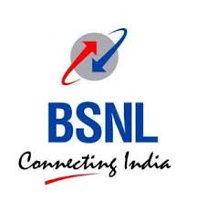
[TELEPHONE BHAWAN]
NAME- SRIJAN TRIPATHI
REG NO- RA1711003030187
CLASS- CSE C

Slide 2
ACKNOWLEDGEMENT
It gives me immense pleasure to express ours profound gratitude to ours bonafide University, SRM INSTITUTE OF SCIENCE AND TECHNOLOGY to encourage students to undergo summer training to gain valuable practical experiences from various industries and companies. I extend my thanks to SDE in charge of training Mr.j mandal, who encouraged us to undergo this implant training at BSNL’s Advanced Training Centre, Patna.
I also extend my thanks to all the faculties and teaching staff at BSNL for their invaluable support and assistance.
Lastly I would like to thank all the employees/respondents of BSNL, Patna.

Slide 3
ABOUT THE ORGANISATION
I did my industrial training from BSNL. Bsnl is India’s oldest and largest Communication Service Provider. Currently BSNL has a customer base of 64.8 million. It has footprints throughout India except for the metropolitan cities of Mumbai and New Delhi which are managed by MTNL. As on March 31, 2010 BSNL commanded a customer base of 33.7 million Wireline, 3.6 million CDMA-WLL and 27.5 million GSM mobile subscribers. BSNL’s earnings for the Financial Year ending March 31, 2010 stood at INR 401.8b with net profit of INR 89.4b. Today BSNL is India’s largest telecom and one of largest Public Sector Undertaking of the country with authorized share capital of INR 17,500 Crores.

Slide 4
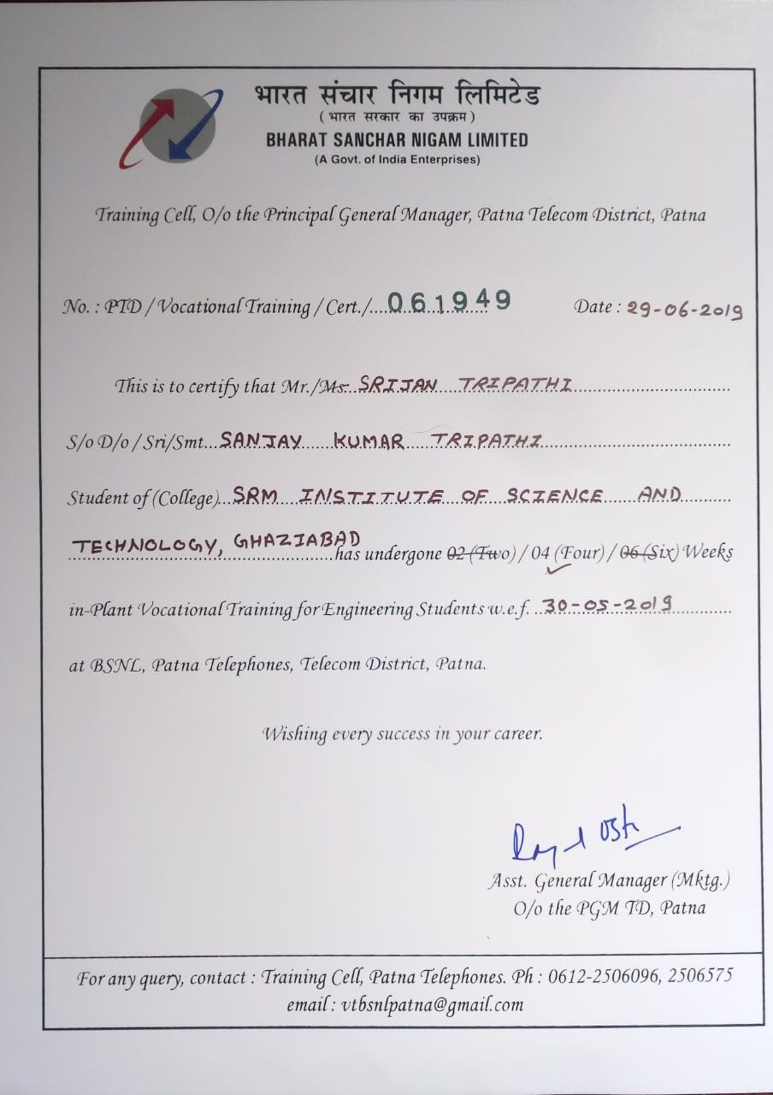
CERTIFICATE

Slide 5
TOPICS COVERED
LOCAL AND TRUNK LINE
PCM
FIBRE OPTICS COMMUNICATION
OVERVIEW OF MOBILE COMMUNICATION
GSM TECHNOLOGY
CDMA TECHNOLOGY
INTRODUCTION TO INTERNET AND BROADBAND

Slide 6
VOIP- INTRODUCTION AND BACKGROUND
The technology of Voice over Internet Protocol (VoIP) involves using the technology of the Internet Network to deliver voice communications and multimedia session as packets over the network. Because VoIP is a telephony service, it is also referred to as broadband phone service, internet telephony, IP telephony, and broadband telephony. Due to the affordances of Internet-ready phones, and the fact that the IP is the communication protocol of most devices, VoIP is best positioned to be the service platform for next-generation application. The Public Switched Transfer Network (PSTN) on the other hand is a connection-oriented, circuit-switched network that uses dedicated channels for transmission. The PSTN had switched to transmitting digital signals to solve the problems associated with its original analog transmission using Pulse Code Modulation (PCM) to convert all analog signals into digital transmissions at the calling and receiving ends. However, the PSTN suffers two significant disadvantages: high cost resulting from the expensive bandwidth and an inefficient use of networking channels. VoIP unlike its predecessor, the PSTN which is currently built on a closed infrastructure; is built on an open infrastructure and several vendors can provide applications and access. While the PSTN technology involves vendors only building applications specific for their equipment and its current architecture has not made it possible for many vendors to write new applications for it; VoIP allows the development of more creative solutions and applications as well as the convergence of data, voice and video in one channel.
VOIP is a protocol which is used to deliver voice iformation digitally over the same network which we use for the internet. reduces the cost. reduce the no of physical connection as each employee can have their own virtual extension. In this the voice messages are sent from one device to other in the form of packets.

Slide 7
VOIP- INTRODUCTION AND BACKGROUND
This research is aimed at simulating a VoIP-based telephony service using a university communication system. We believe that if we can successfully implement the simulation, and given the advantages of VoIP over the traditional PSTN technology, a modern telephony system can be implemented for the campus. The researchers aimed at reducing cable clusters around offices, facilitating in-office communication and enabling conference calling at any point where the IP phone or VoIP phone is being installed. The project covered the interconnection of different offices and the researchers, with the help of simulation showed that it was possible to make cheaper calls using the desk IP phone and video streaming on the Soft Phones and interfaces installed on Personal Computers (PC).

Slide 8
DHCP CONFIGURATION
The Dynamic Host Configuration Protocol (DHCP) is a network management protocol used on UDP/IP networks whereby a DHCP server dynamically assigns an IP address and other network configuration parameters to each device on a network so they can communicate with other IP networks. A DHCP server enables computers to request IP addresses and networking parameters automatically from the Internet service provider(ISP), reducing the need for a network administrator or a user to manually assign IP addresses to all network devices. In the absence of a DHCP server, a computer or other device on the network needs to be manually assigned an IP address, or to assign itself an APIPA address, which will not enable it to communicate outside its local subnet.
DHCP is anetwork management protocol. DHCP works on client server model. It enables the server to automatically assign an IP address to a computer from from a defined name of numbers configured for a given network

Slide 9
PROJECT DESCRIPTION
Components Used:
There are 2 computers, 4 IP phones, 2 Router (2811 series), 2 Switch (2960-24TT series) used in the project.
The Router is connected to the Switch through straight wire which is then connected to the 2 IP phones and a Computer. Same process is done for the second router. The two routers are then connected to each other.

Slide 10
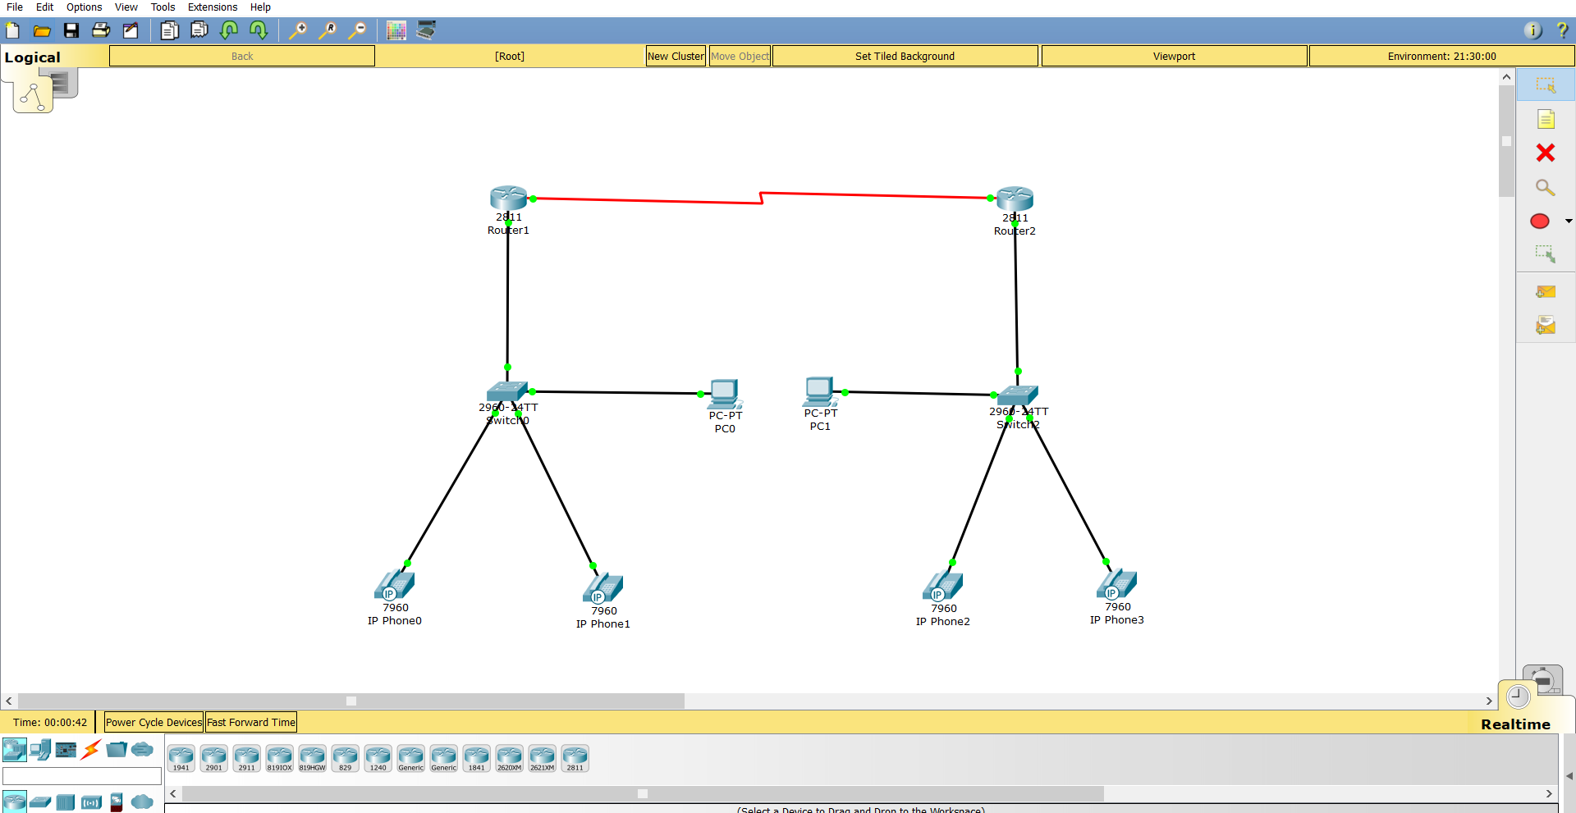
Project Interface

Slide 11
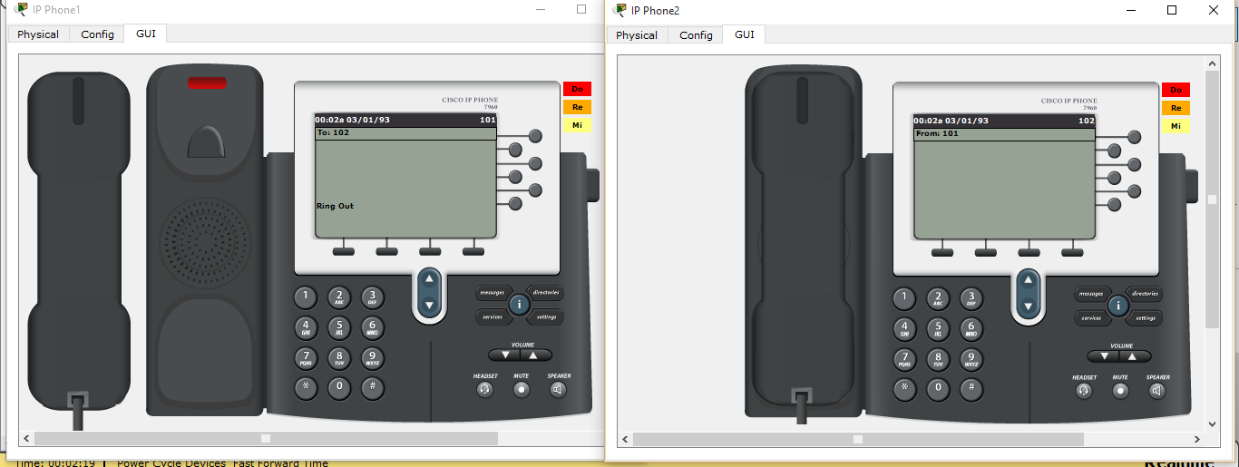
Project Output:

Slide 12
Significance of Project:
The project simply points out the working of a Voice over IP phone (VoIP) and how it is configured to be used in a real time business organization.
VoIP is important because, for the first time in more than 100 years, there is an opportunity to bring about significant change in the way that people communicate. In addition to being able to use the telephones we have today to communicate in real-time, we also have the possibility of using pure IP-based phones, including desktop and wireless phones. We also have the ability to use videophones, much like those seen in science fiction movies. Rather than calling home to talk to the family, a person can call home to see the family.
One of the more interesting aspects of VoIP is that we also have the ability to integrate a stand-alone telephone or videophone with the personal computer. One can use a computer entirely for voice and video communications (softphones), use a telephone for voice and the computer for video, or can simply use the computer in conjunction with a separate voice/video phone to provide data conferencing functions, like application sharing, electronic whiteboarding, and text chat.
VoIP allows something else: the ability to use a single high-speed Internet connection for all voice, video, and data communications. This idea is commonly referred to as convergence and is one of the primary drivers for corporate interest in the technology. The benefit of convergence should be fairly obvious: by using a single data network for all communications, it is possible to reduce the overall maintenance and deployment costs. The benefit for both home and corporate customers is that they now have the opportunity to choose from a much larger selection of service providers to provide voice and video communication services. Since the VoIP service provider can be located virtually anywhere in the world, a person with Internet access is no longer geographically restricted in their selection of service providers and is certainly not bound to their Internet access provider.
In short, VoIP enables people to communicate in more ways and with more choices. Hence the project has been made to bring about the widespread scope of the VoIP.

Slide 13
THANK YOU

